Slide 1


BAM 2102: ENTREPRENEURSHIP PRINCIPLES
By
Nasinyama Moses Makoha
E-mail: mmakoha@gmail.com
Tel: +256 78 (70) 2-86 56 45

Slide 2
Introduction to Entrepreneurship
Meaning
Entrepreneurship comes from a French word `Entrependre’ and the German word `Uternehmen’ both meaning individuals who are `undertakers’ i.e. those who took the risk of a new enterprise.
Entrepreneurship is a dynamic activity which helps the entrepreneur to bring changes in the process of production, innovation in production, new usage of materials, creator of market etc.
It is a mental attitude to foresee risk and uncertainty and do something new in an effective manner to achieve certain goals.

Slide 3
An entrepreneur is an economic change agent with knowledge, skills, initiative, drive and spirit of innovation to achieve goals. He identifies and seizes opportunity for economic benefits. He is a risk bearer, an organizer and an innovator.
According to Economists: An entrepreneur is the one who brings resources, labour, material and other assets into combination to produce a socially viable product, and also one who introduces changes, innovation and new order.
According to Management: A person with a vision and action plan to achieve it is an entrepreneur

Slide 4
Functions & Characteristics of an entrepreneur
Functions of an Entrepreneur
Identification of opportunities
Introduction of a new product
Gathering resources or Introducing new methods of production
Developing new markets
Characteristics of an Entrepreneur
Vision: He is able to visualize market demand, socio-economic environment and the future of business venture.
Knowledge: He has sound conceptual knowledge about all the technicalities of his business.

Slide 5
Desire to succeed – He has multiple goals and a seeks opportunities to be productive.
Independence – He is independent in work and decision making
Optimism – He knows how to exploit opportunities.
Value addition – He does not follow the conventional rule of thumb, they have a desire to create, innovate and add value.
Initiative – He takes the initiative to make an action plan from limited resources.
Goal setting – He sets realistic goals.
Problem solver – He is creative in problem solving.
Good human relations – He is a good leader, motivator and team builder.
Communication skills – He has the ability to persuade others.

Slide 6
Types of Entrepreneur
(i) According to Clarence Banhof
Aggressive/Innovative entrepreneur: The one who uses various combinations of information and factors of production to assemble and engineer new and innovative products.
Imitative/Adoptive entrepreneur: The one who simply adopts a successful innovation introduced by other entrepreneurs.
Fabian entrepreneur: The one who is timid and cautious in making bold decisions. Such an entrepreneur adopts innovations in his business only when he fears that not innovating may damage his business.
Drone entrepreneur: A drone entrepreneur is one who refuses to adopt new innovations even at the cost of reduced returns.

Slide 7
(ii) According to Authur H. Cole
Empirical entrepreneur: An entrepreneur who does not innovate and follows the rule of thumb.
Rational entrepreneur: An rational entrepreneur is one who keeps himself updated with his business, the market and economic conditions, and introduces revolutionary ideas.
Cognitive entrepreneur: An entrepreneur that seeks advice and services of experts to make changes which are revolutionary and reflect a complete shift from its existing structure.

Slide 8
(iii) According to Ownership
Public entrepreneurship: These are individuals who partner with the government to create enterprises which serve the public in innovative ways.
Private entrepreneurship: These entrepreneurs are profit oriented and do not enter market which have low monetary rewards associated with it.
(iv) According to Scale of enterprise:
Large scale entrepreneur – Large scale entrepreneurs are usually found in developed countries. These entrepreneurs introduce revolutionary ideas and are able to sustain high profits and develop new technologies as they possess the financial capacity and necessary resources to do so.
Small scale entrepreneur – Small scale entrepreneurs do not have the necessary funds and technology to initiate large scale production and introduce revolutionary ideas.

Slide 9
Nature of Entrepreneurship
Creation of an enterprise – It involves creation and operation of an enterprise.
Organizing function – It brings together various factors of production for economic use.
Innovation – It is an automatic, spontaneous and creative response to changes in the environment.
Risk bearing capacity – It assumes uncertainty of future.
Managerial and leadership function – It is responsible for controlling and coordinating the human resource and giving direction to an enterprise.
Gap filling – It fills the gap between human needs and available products and services.

Slide 10
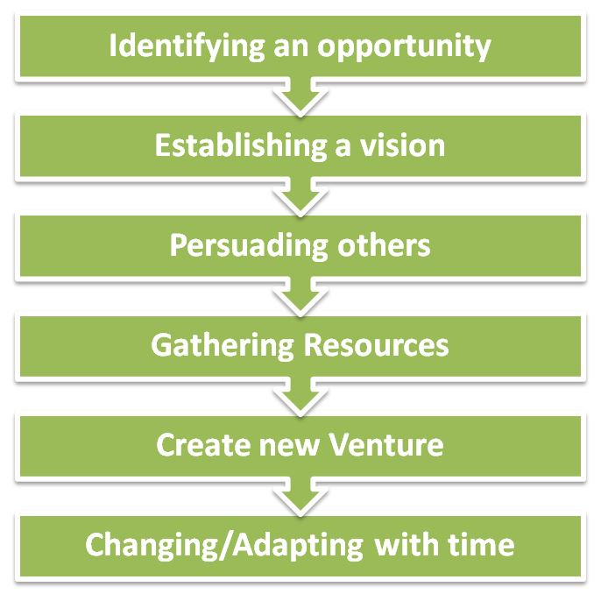
Process of Entrepreneurship

Slide 11
Process of entrepreneurship explained
(A) Identify an opportunity: An Entrepreneur senses opportunities and visualizes a market since they are creative and open to new ideas and seek challenges. They look for needs, wants, problems and challenges that are not met or dealt effectively. Since their ideas are innovative they gain first movers advantage which provides product identification and higher credibility in the market.
(B) Establishing a vision: It involves generation of ideas using past experience and creativity to develop new and innovative ways to solve a problem, or satisfy a need. Out of many ideas the most feasible and profitable are chosen and narrowed to one best idea. He evaluates different opportunities and the business environment to assess the (i) Real and Perceived value of the product/service (ii) Risks and rewards associated with the project (iii) and differential advantage in its competitive environment.

Slide 12
C) Persuade others – He forms a foundation team which consists of a group of individuals who work together to turn his vision into reality. They may be partners, financiers, family members etc.
(D) Gathering Resources – It involves using a business plan to attract investors, venture capitalists, partners, financial institutions, promoters etc. The main task is to research and identify resources that are needed to turn the idea into a viable venture.
Resources can be categorized into:
Financial Resources: Personal savings, retained capital, banks, government institutions, family, friends, partnerships, venture capital, public issue.
Operating Resources: They can be Tangible or Intangible.

Slide 13
Tangible resources include: (a) machines (b) raw materials (c) land and building (d) office equipment (An entrepreneur has to make a decision to buy, rent or hire them).
Intangible resources include: (a) company’s image (b) operating procedures (c) transportation (d) management
Human resources include: Temporary/permanent employees, Amount of man power needed, Recruitment, Selection and Training of staff, Compensation, Organization culture.
Information resources include: An efficient management information system is needed in order to have timely info about customers, markets, competitors and external environment. All the data is networked on real time basis to speed up actions based on information.

Slide 14
(E) Create new Venture – When all the resources have been arranged, the next step is Creation and establishment of a new venture and running the business venture successfully. It requires a lot of enthusiasm and persuasion to gather optimum resources and it requires a lot of perseverance and passion to believe in self.
(F) Change/Adapt with time – It is necessary to monitor and upgrade the organization with changing market conditions. It requires availability of funds to make changes and the adaptability of human resource towards changed environment.

Slide 15
Functions of Entrepreneurship
Primary Functions
Planning
Organizing
Decision Making
Managing
Innovating
Risk bearing
(B) Secondary Functions
Diversification of production
Expansion of the enterprise
Maintaining cordial employer and employee relations
Tackling Labour problem
Coordinating and communicating with third parties
Other Functions
Managing of scarce resources
Dealing with public bureaucracy
Identifying parallel opportunities
Building Strong customer relations

Slide 16
Barriers to Entrepreneurship
(i) Environmental Barriers
(a) Raw Material: Non-availability of raw materials required for production during peak seasons. It leads to increase in price of raw materials due to competition.
(b) Labour:
Lack of skilled labour
Lack of committed and loyal employee
Quality and Quantity of labour

Slide 17
(c) Machinery: Machines are necessary but they are also costly and due to rapid change in technology they become obsolete and require replacement which requires cash in hand. It becomes very difficult for small business organization to keep updating its production process.
(d) Land and Building: Acquisition of land and construction of building at a prime location require heavy expenditure. If the land is taken on rent, it becomes a fixed cost and a constant concern for the entrepreneur.
(e) Infrastructure support: Adequacy of power, proper roads, water and drainage facilities etc. There is less support from development authorities due to red-tapism and corruption.

Slide 18
ii) Financial barrier: Availability of funds is a major concern. A delay in source of finance results in delay of starting or running business.
(iii) Personal Barrier: They are caused by emotional blocks of an individual causing mental obstruction leading to:
(a) Lack of confidence: They think they will never find a successful business idea and would be unable to attract necessary resources. Therefore, they dismiss the thought of being self-employed.
(b) Lack of Dependability on : They aim to gain their additional expertise through trail and error and experience, rather than seeking further development or personal assistance from others.

Slide 19
(c) Lack of Motivation: Lose interest and motivation when ideas don’t work.
(d) Lack of Patience: When desire to achieve success in first attempt or to become rich instantly are confronted with business challenges/problems they lose interest. They give up at during initial losses.
(e) Inability to Dream: Sometimes they are short of vision or satisfied with what they have achieved and lose interest in further expansion of business.
(f) Sense of Pride/Embarrassment: they are too proud or too embarrassed to take help.

Slide 20
(iv) Societal Barrier
Socio-cultural norms and values
Degree of approval or disapproval of entrepreneurial behaviour
Financial stability and family background
Caste and religious affiliation
(v) Political Barrier
Government incentives and concessions
Facilitating socio-economic setting
interest in economic development of society

Slide 21
State of Entrepreneurship in Uganda
Introduction
Entrepreneurship is a recent phenomena in Uganda
Uganda was a substitance economy till 1903
Coffee was introduced to enable locals to pay tax
From 1903 to 1950s, Africans were not encouraged to participate in business
Y.K. Musaazi led the struggle to have African enter entrepreneurship in the 1950s
At Independence Eve 1962
Government had started UDC in 1954 to spearhead industrial and commercial agricultural development
A class of Indian entrepreneurs had developed
African were engaged in agricultural production and largely in stalls in local markets
World Bank report encouraged continual of the status quo

Slide 22
Immediate Post Independence (1960-1970)
Government role in business increased despite World bank recommendations to the country
Private sector grew largely driven the Indian community
African continues to produce agricultural products marketed by the Indian community
1967-more to left by the Milton Obote nationalism of foreign owned businesses
1970s, The Idi Amin Era
Expelled the Asian community
Most foreigners left the country
Business abandoned
Some were nationalized, others given away to Africans
A small group of African entrepreneurs rose to prominence
A large group that was given the businesses rose but collapsed

Slide 23
1n 1986 To Date
Liberalization of the economy
Sell off of government enterprises
Encouraging those that left in the 1970s to return
Encouraging of private investor to come to Uganda
Current State
A large number of foreign entrepreneurs
A large number of small entrepreneurs
Africa business continue to be informal and in markets
A small sector of African entrepreneurs continue to succeed
Entrepreneurial Activity In Uganda
Ranked as one of the most entrepreneurial countries in the world
Total entrepreneurial activity index 33.7% in 2009
That is 34% of Ugandans will start businesses
Comparable international figures.
U.S 7%,
U.K 8%,
Japan 5%,
Ghana 41%

Slide 24
Determinants of Entrepreneurship
Attitudes to risk
Skills sets
Level of poverty
Financial system
Infrastructure
Government support
Challenges of Entrepreneurship in Uganda
Low level of scientific development
Low level of technological adoption
Low levels of productivity
Poor quality of entrepreneurial opportunities
Unsupportive legal environment
Poor infrastructure
Entrepreneurial Opportunities in Uganda
Driven by demographic change, social change, economic change, regulatory change and technological change
Unlike other countries, technology is not changing, therefore low quality of opportunities
The Way Ahead
Change in education system
Emphasis on science
Development of entrepreneurship and management skills
Improvement in infrastructure
Better legal framework

